Slide 1
Basic ER Data Model
& An Erwin Tutorial
MIS 634
Business Intelligence & Data Integration - LAB

Slide 2
Database Development Life Cycle
Requirements Analysis
Database Designing
Implementation
Business Process
Business Concept & Rule
Conceptual Design
Logical Design
Physical Design
etc.

Slide 3
Entity-Relationship Modeling / Diagram
Entity Relationship Model (ER Modeling) represents real-world entities and the relationships among them.
An Entity Relationship Diagram (ER Diagram) is a type of flowchart that illustrates how “entities” such as people, objects or concepts relate to each other within a system.

Slide 4
Types of Data Models - 1
Feature | Conceptual | Logical | Physical
Entity | o | o
Entity Relationship | o | o
Attributes |  | o
Primary Key |  | o | o
Foreign Key |  | o | o
Table |  |  | o
Column |  |  | o
(Column) Data Type |  |  | o
ER Diagram | o | o
Data Structure Diagram |  |  | o

Slide 5
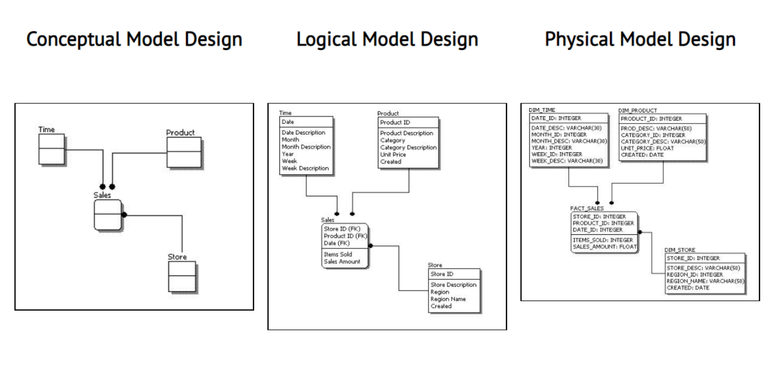
Types of Data Models - 2

Slide 6
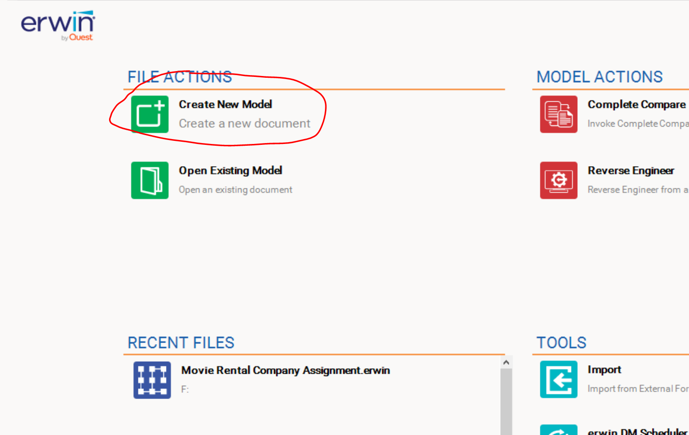
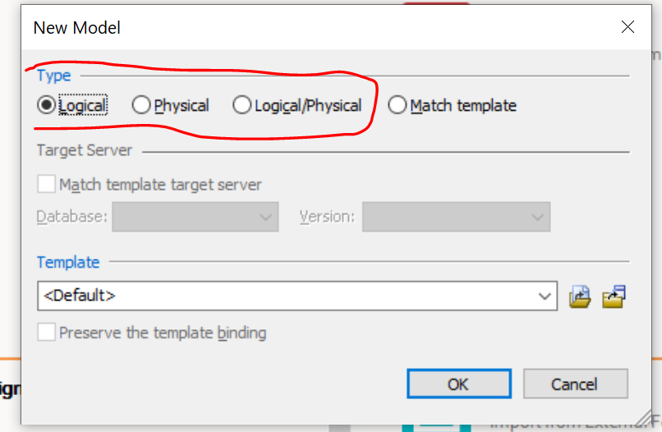
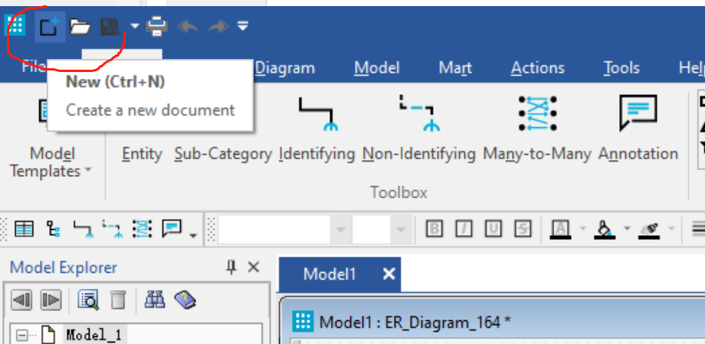
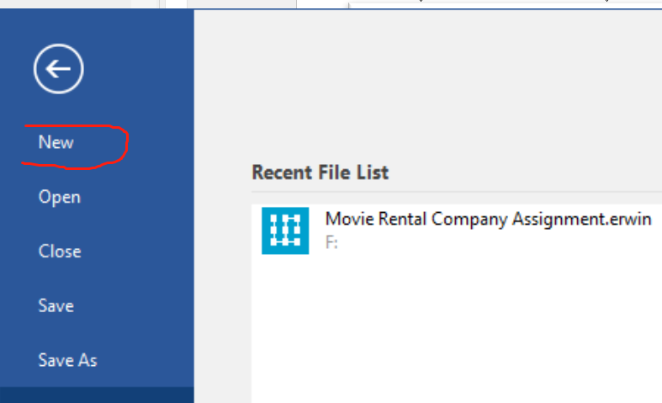

Operation Tips
Create a new model
Choose Model Type

Slide 7
The Components of ER Model
Entity-Relationship Model consists of the following:
Entities: Definable concept or object within a system
Attributes: Characteristics of a given entity
Relationships: Definition of how entities relate to each other

Slide 8
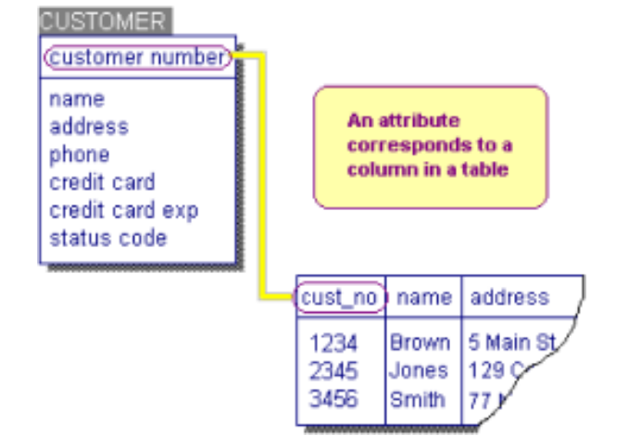
Entity
An entity is an object or component of data
In the model, entities represent the tables in a database

Slide 9
Attributes
Characteristics of a given entity
Logical attributes usually correspond to physical columns in a table.

Slide 10
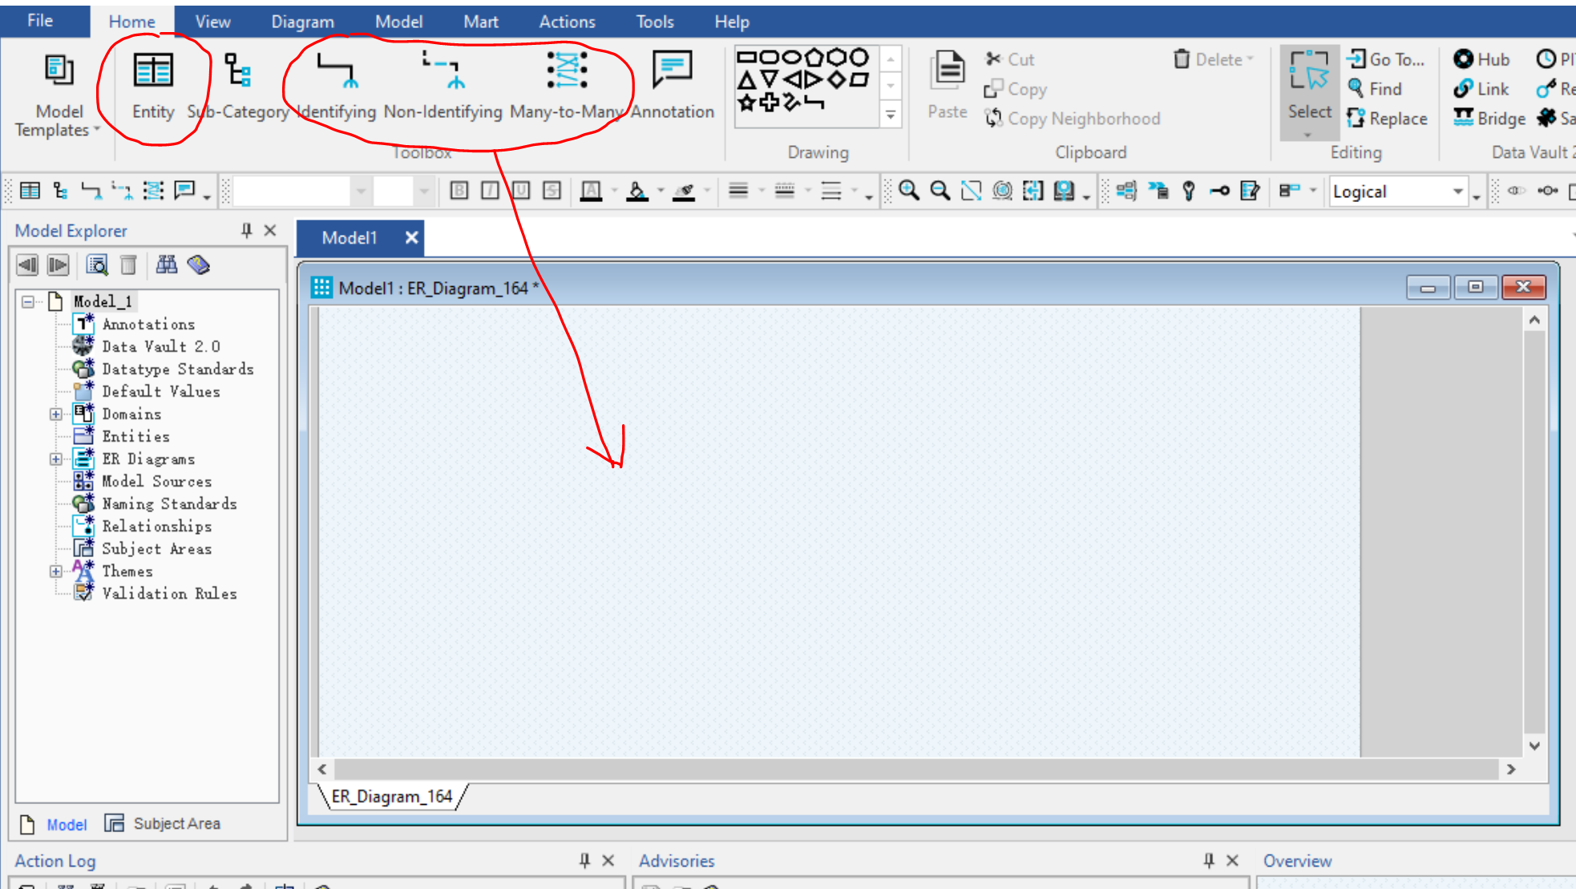
Operation Tips
Create entity and relationship
Toolbox
Diagram Window

Slide 11
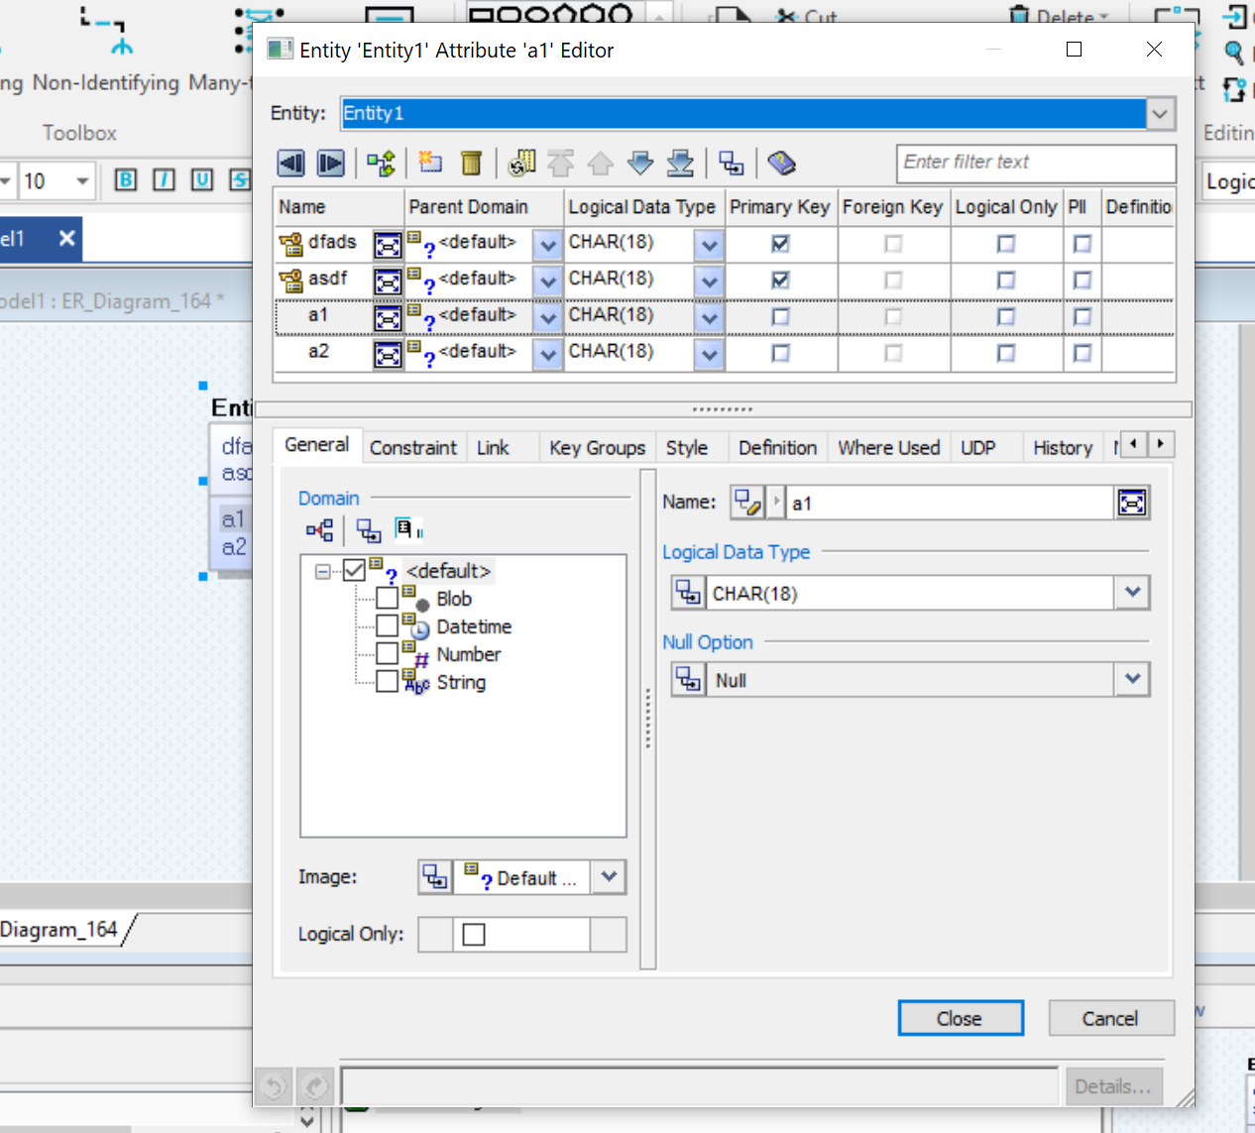
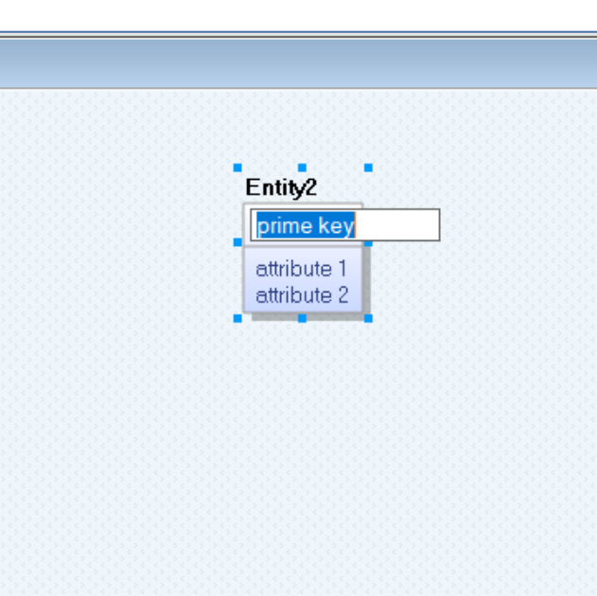
Operation Tips
Edit the Entities/Attributes by Entity Property/Attribute Property
Right click attribute
Double click attribute
Edit the Entities/ Attributes Directly
Double click entity/attribute
Enter: next item in a section
Tab: next section

Slide 12
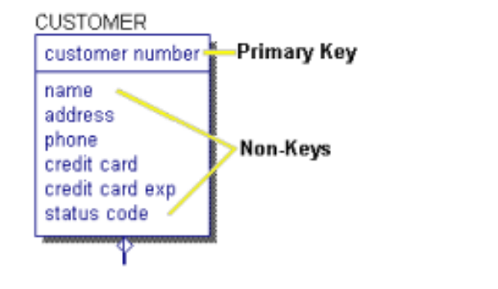
Primary Key and Non-Keys
The area above the horizontal line is known as the key area because that is where the entity's primary key resides. The primary key can be comprised of one or more attributes that uniquely identify the entity.
The area below the horizontal line is known as the non-key area because that is where all other attributes reside.

Slide 13
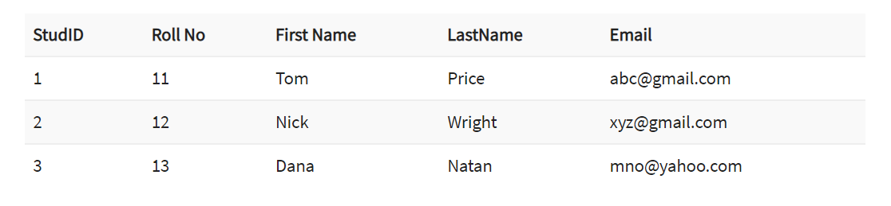
Primary Key
Primary Key:
Uniquely identify an instance.
Never include a NULL value.
Not changing over time.
Be as short as possible, to facilitate indexing and retrieval
Alternate Key Attributes:
Used to identify the different indexes.
For quick data access.
In this table, StudID, Roll No, Email are qualified to become a primary key. But since StudID is the primary key, Roll No, Email becomes the alternative key.

Slide 14
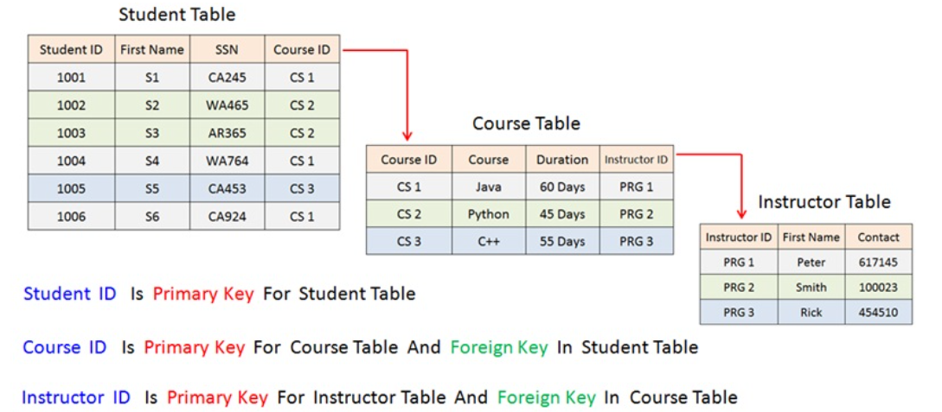
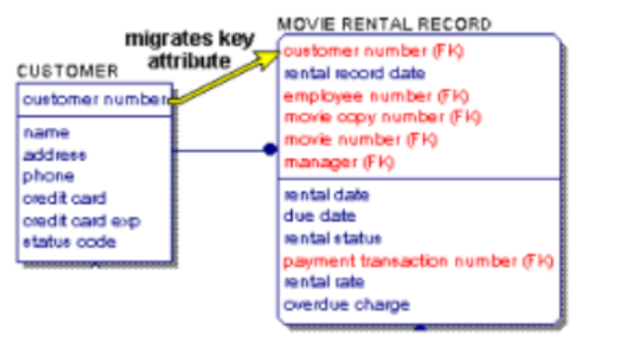
Foreign Key
When the primary key of one table/entity (parent table/entity) is included as an attribute/key into another table/entity (child table/entity) then such key is referred as Foreign Key.
The main purpose of the foreign key is to create and define the relationship between two entities/tables.

Slide 15
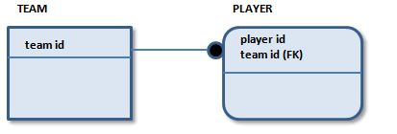
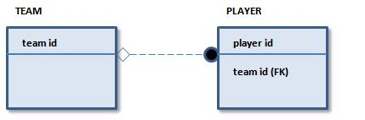
Relationship Type in Erwin
Identifying Relationship:
An identifying relationship is represented by a solid line and through it the primary key of the parent migrates to the primary key area of the child entity or table.
Non-Identifying Relationship:
A Non-identifying relationship is represented by a dashed line and through it the primary key of the parent migrates to the non-key area of the child entity or table.
Many to Many Relationship
A many-to-many relationship is a relationship between two entities where instances in one entity have zero, one, or more related instances in the other entity.

Slide 16
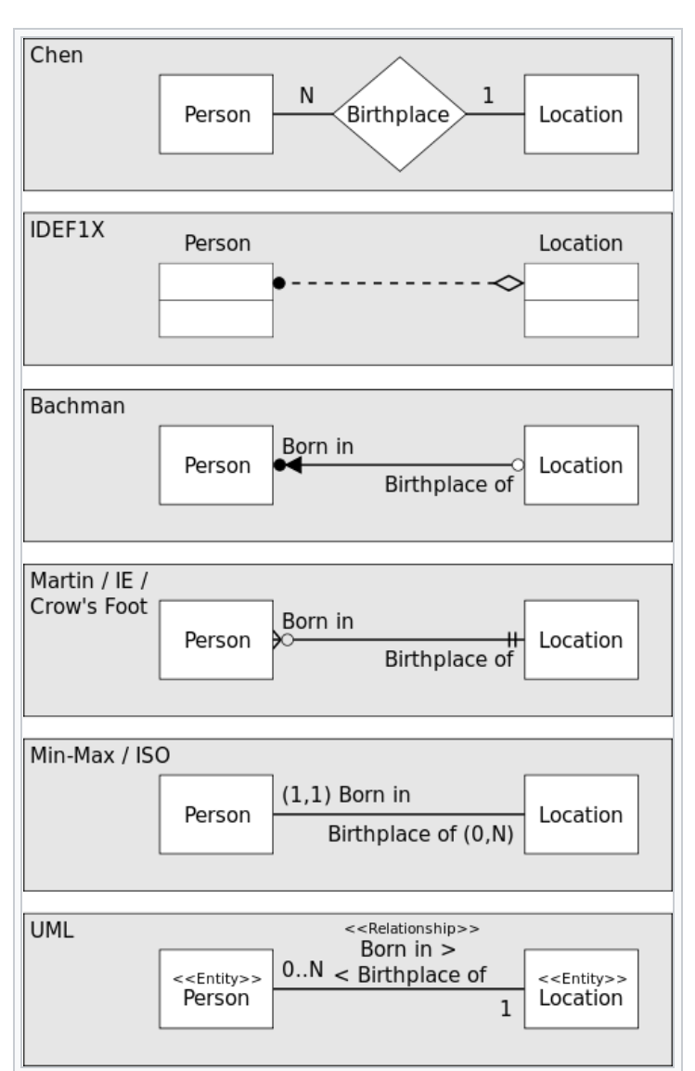
Data Modeling Notations
Erwin’s Notations:
IDEF1X: Developed by United States Air force and currently used in various government agencies and in a wide variety of major corporations from aerospace to financial industries.
IE (Information Engineering): James Martin, Clive Finkelstein, and other IE authorities developed the IE method, which is widely deployed in various industries.

Slide 17
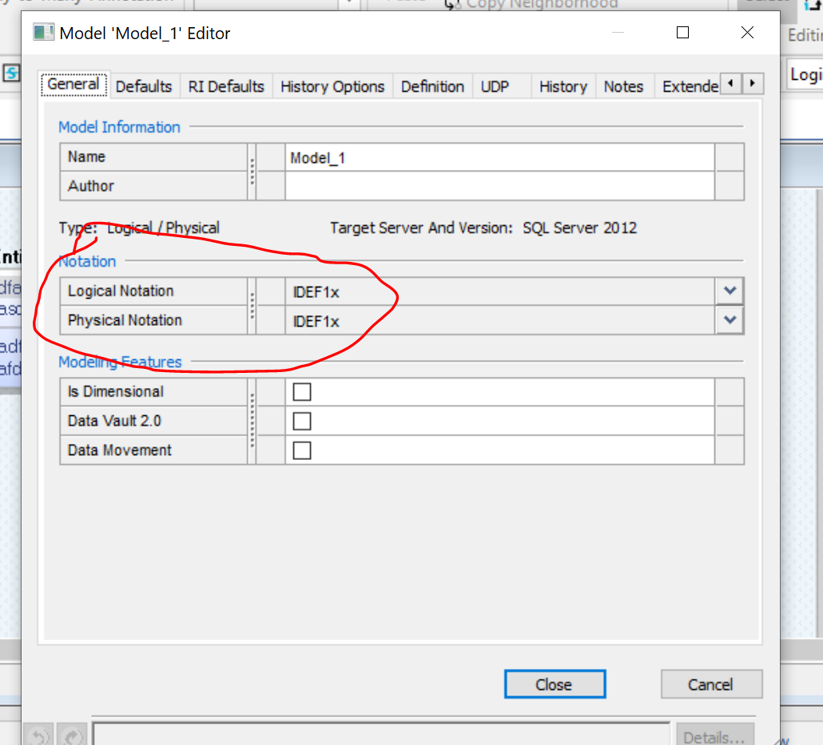
Operation Tips
Choose Notation

Slide 18
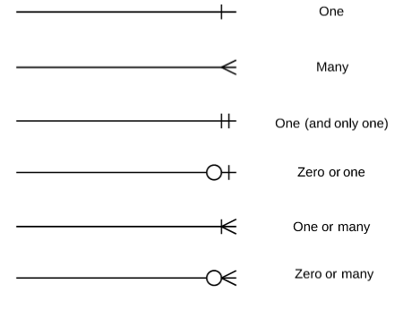
Data Modeling Notations (IE) – Relationship

Slide 19
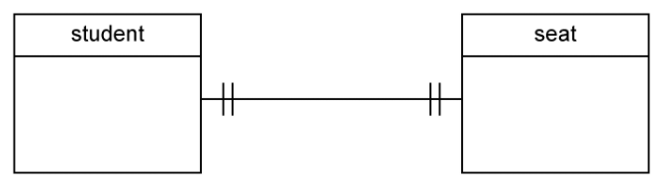
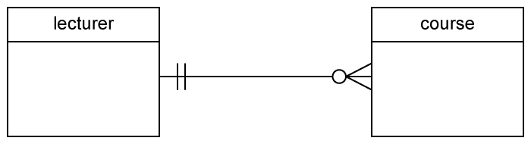
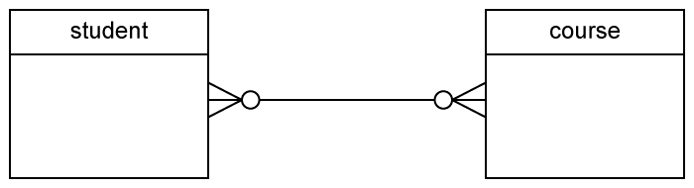
Data Modeling Notations (IE) – Relationship
One to One
One and Many
Many to Many

Slide 20
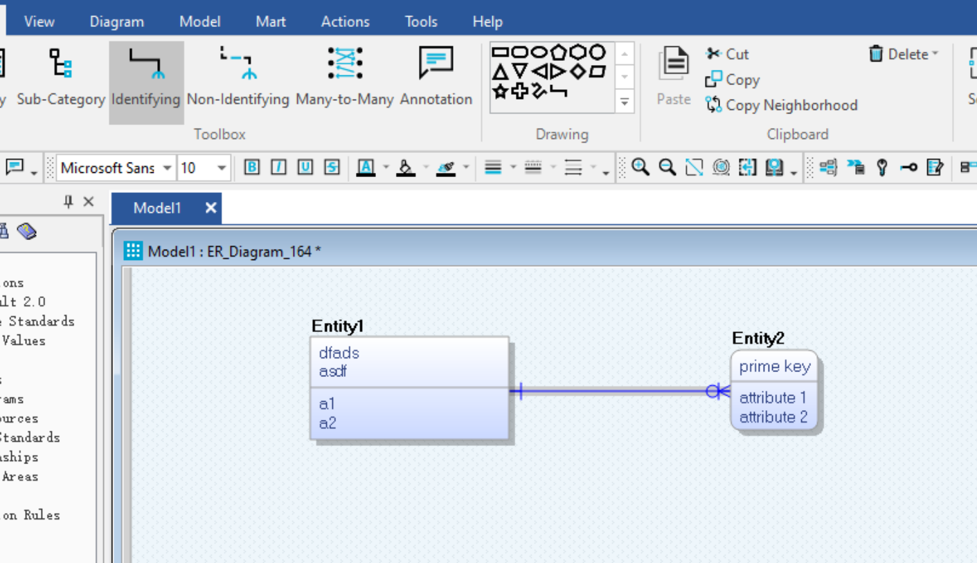
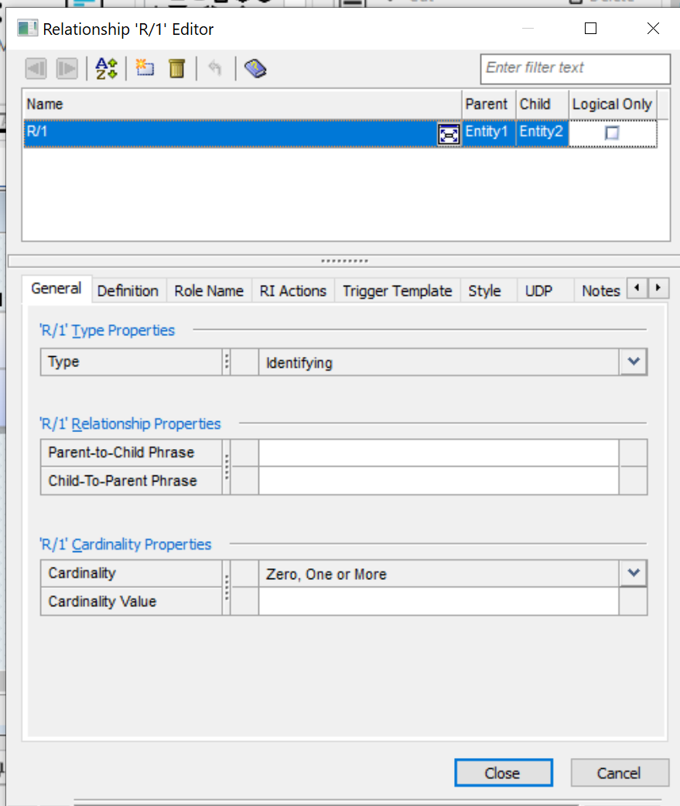
Operation Tips
Edit Relationship → Relationship Property
Right click
Double click
Create Relationship

Slide 21
Sample Data
CustomerID | Customer Name | Contact Phone | Country | Employee Number | Employee Name | Email | Office Code | Office Location | OrderID | Order Date
101 | Atelier graphique | 40.32.2555 | France | 1002 | Murphy | dmurphy@abc.com | NULL | Paris | 1.22E+14 | 2021-02-28 16:13:42 EST
102 | Signal Gift Stores | 7025551838 | USA | 1056 | Patterson | mpatterso@ abc.com | usa1002 | NYC | 1.39E+10 | 2021-02-28 15:59:02 EST
103 | Australian Collectors, Co. | 03 9520 4555 | Australia | 1143 | Bow | abow@abc.com | aus7711 | Sydney | 1.39E+10 | 2021-02-28 15:44:36 EST
104 | La Rochelle Gifts | 40.67.8555 | France | 1165 | Jennings | ljennings@abc.com | eup5439 | Paris | 1.39E+10 | 2021-02-28 15:44:16 EST

Slide 22
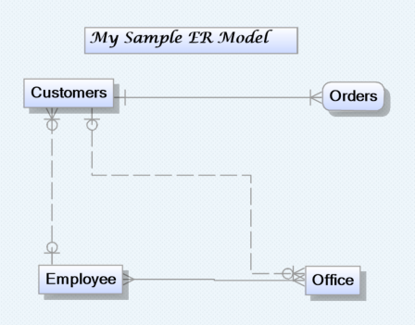
ER Diagram Sample:
How to only display entity?
Diagram Property
“Display tab”

Slide 23
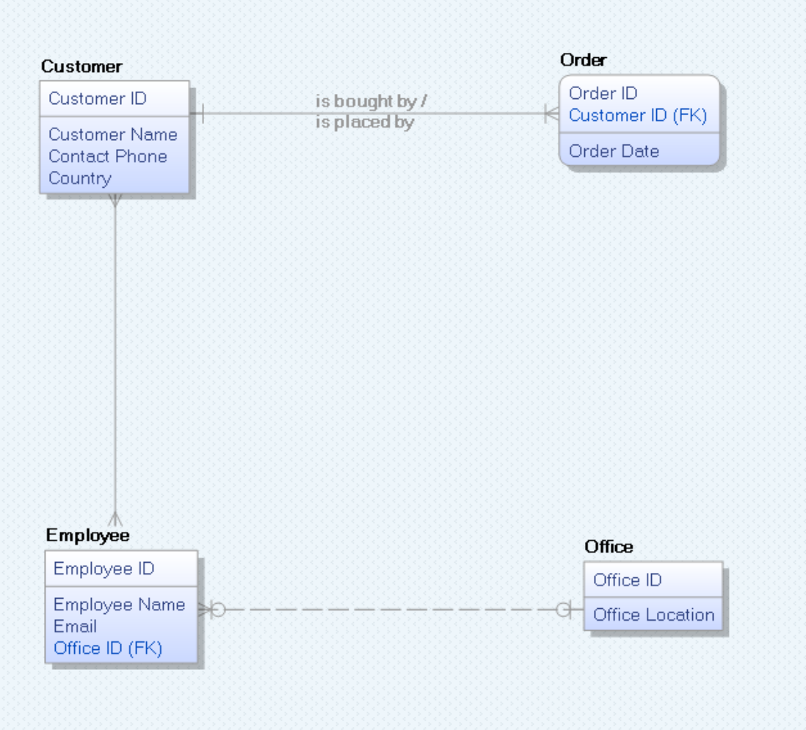
ER Diagram Sample:
To be Continuous

